Slide 1

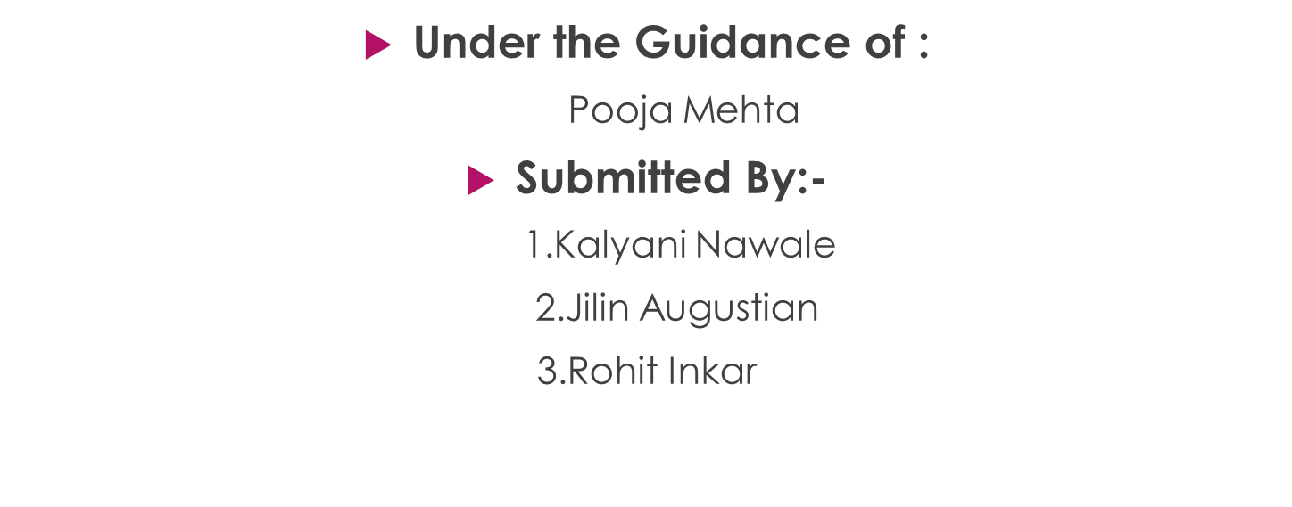
BOOK KEEPING SYSTEM

Slide 2
INTRODUCTION
The book keeping system project has been developed on angular and database. This system focuses on building an enhancing bookkeeping skills. System helpful for handling all book related information. Using this we can get idea that how much books available simply system easily handle all books ,Orders , and all related information. It is used by librarian to manage the library record various transactions like issue of books, return of books, addition of new books etc. It will track on the how many books available in library and books issued to the students.

Slide 3
PROJECT OBJECTIVE
The purpose of our project is to handle the all books related records easily. And handle all students records. System helpful to find all records easily and handle it properly. Main motive of project is to arrange all books related data properly so that whenever we want to find how many books available in library it can be easy to find and also which book is given to which student it also make simple to find it.

Slide 4


TECHNOLOGY USED
A database is a structured collection of data that's stored electronically in a computer system.
Java is a multi-platform, object-oriented, and network-centric language that can be used as a platform in itself.
Data-Base
JAVA
Angular is a JavaScript framework written in TypeScript that is used to build single-page applications. It is maintained by Google and is designed for web, desktop, and mobile platforms.
HTML is the standard markup language for creating Web pages. HTML describes the structure of a Web page
HTML
ANGULAR
CSS
CSS is a style sheet language used for specifying the presentation and styling of a document written in a markup language such as HTML or XML

Slide 5



REQUIRED SPECIFICATION
HARDWARE CONFIGURATION
SOFTWARE CONFIGURATION
Operating System: Windows 10 and above
Hard Disk : 500Gb
RAM : 8Gb
Software IDE : Postman, MySQL, VS code.
Language: JAVA, HTML, CSS, TypeScript.
Front End: Angular, Boot Strap
Back End: Spring Boot, MySQL

Slide 6

CONNECTION TO DATABASE
Template
Components
HTTP
Client
Spring
Rest
Controller
Services
Services
Angular
Model
Spring Data JPA
Spring Boot
DATABASE

Slide 7

MODULES
Admin:- Login and add books.
User:- Register and login.
List Of Books:- Add, remove and update books details by admin.
Cart:- User can add books from books list.
Order:- Display list of books order by user.

Slide 8
SPRING ANNOTATION
@CrossOrigin | @CrossOrigin annotation in Spring Boot allows developers to manage cross-origin requests for specific handler classes and method
@RestController | @RestController annotation is a specialized version of the @Controller annotation that's used to create RESTful web services
@PostMapping | @PostMapping annotation in Spring MVC framework is a powerful tool for handling the HTTP POST requests in your RESTful web services.
@GetMapping | It maps HTTP GET requests to a specific handler method in Spring controllers.
@PutMapping | @PutMapping is a composed annotation that acts as a shortcut for @RequestMapping(method = Request Method. PUT) .
@Entity | @Entity used to define and manage entity classes that interact with relational databases
@NotEmpty | @NotEmpty: a constrained CharSequence, Collection, Map, or Array is valid as long as it's not null, and its size/length is greater than zero.
@NotBlank | @NotBlank: a constrained String is valid as long as it's not null, and the trimmed length is greater than zero.

Slide 9







ADVANTAGES
Record Of Books
System helpful for handle all records of books properly. Here all books arranged by each category.
Easy Ordering
This system make easy to order the book, it is helpful for order it carefully.
Accurate Information
Here all records are fully checked and verified.
Time Saving
System helpful to order book easily and make simple to order the book.

Slide 10
CONCLUSION
Bookkeeping system is helpful to handle all records of books easily and category wise this system useful to handle all records that which user order which books and also this system save all reviews from users.
Bookkeeping system handle all users information and also it save all book data like author, publisher and price of books so that user can check the detail information about books and then they can easily order books. This system is usually important for libraries because they handle properly all details about books, users and also save all proper reviews also.

Slide 11
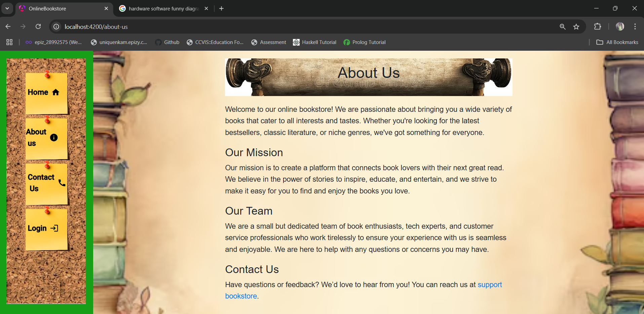
About Us Page:-

Slide 12

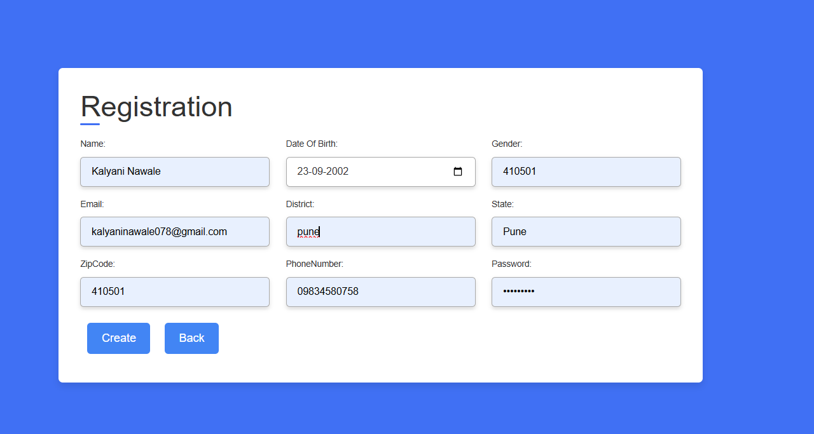
Registration Page:-

Slide 13
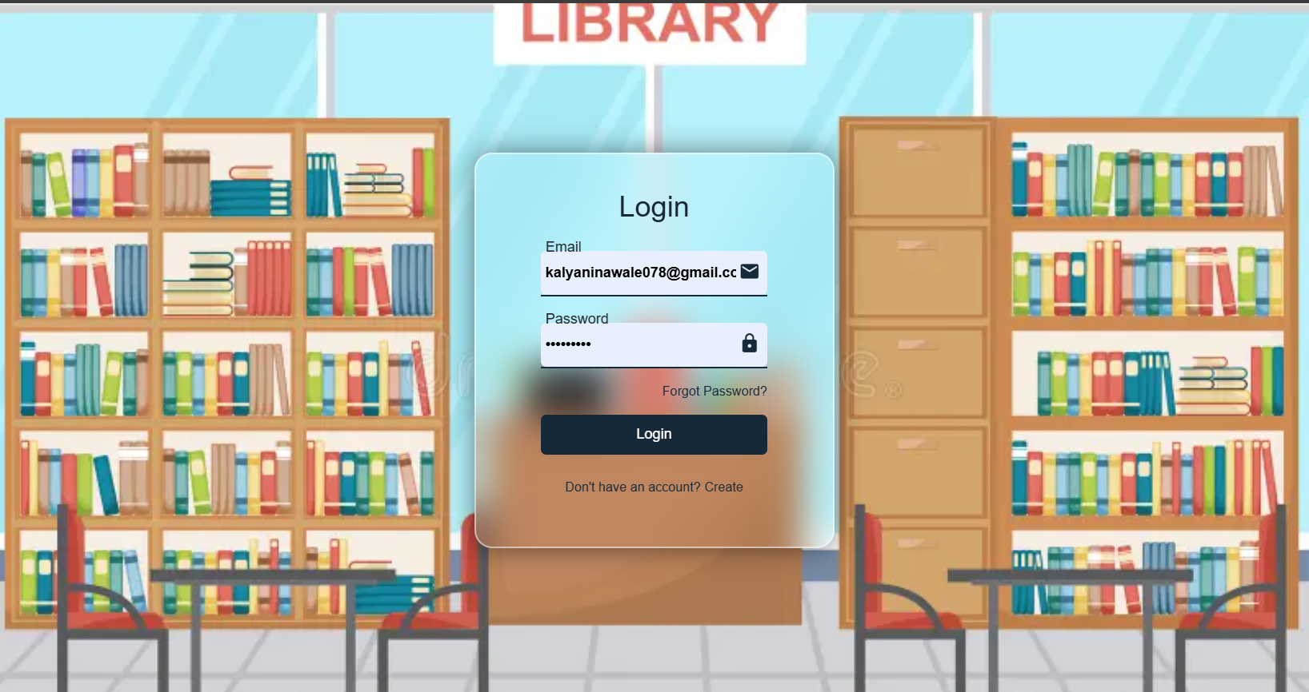
Login Page:-

Slide 14
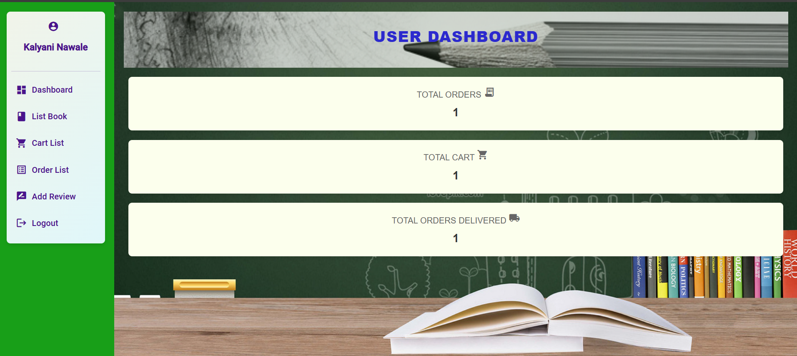
User Dashboard:-

Slide 15
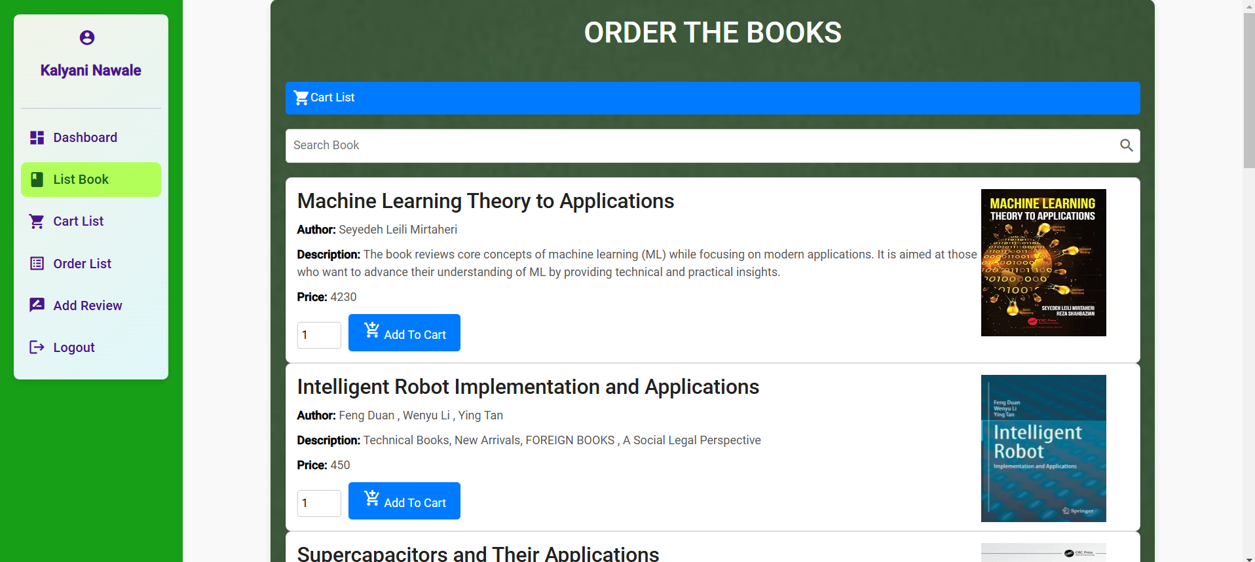
List Of Books:-

Slide 16
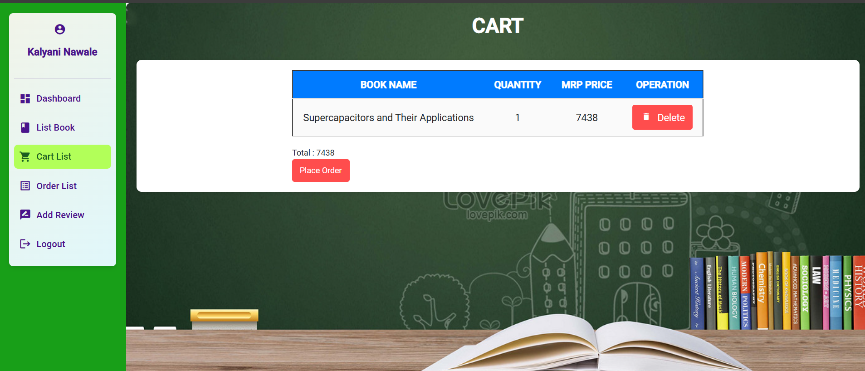
Cart Page:-

Slide 17
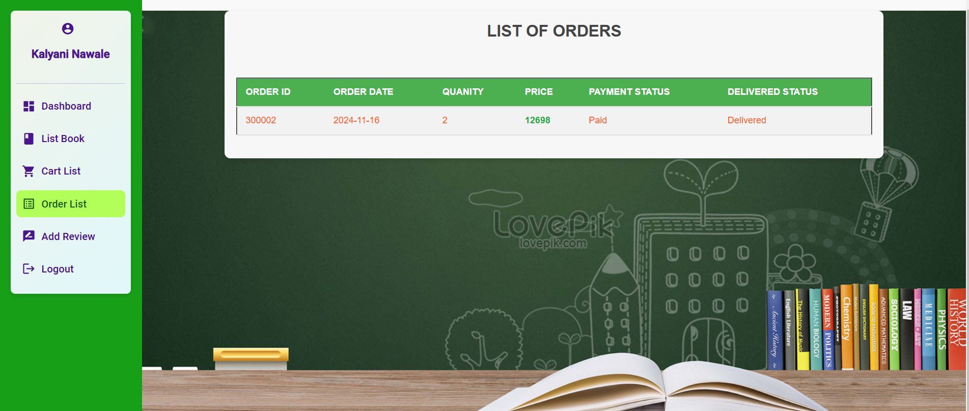
Order Page:-

Slide 18
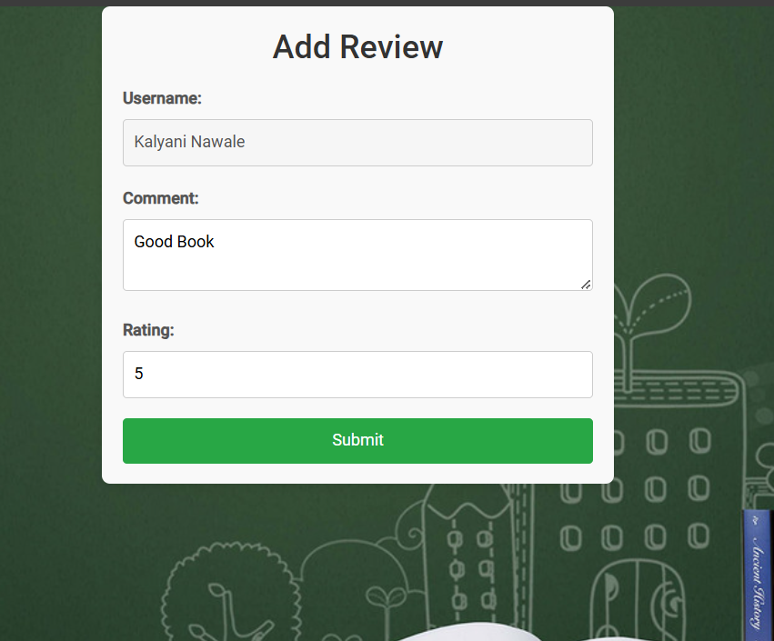
Add Review Page:-

Slide 19
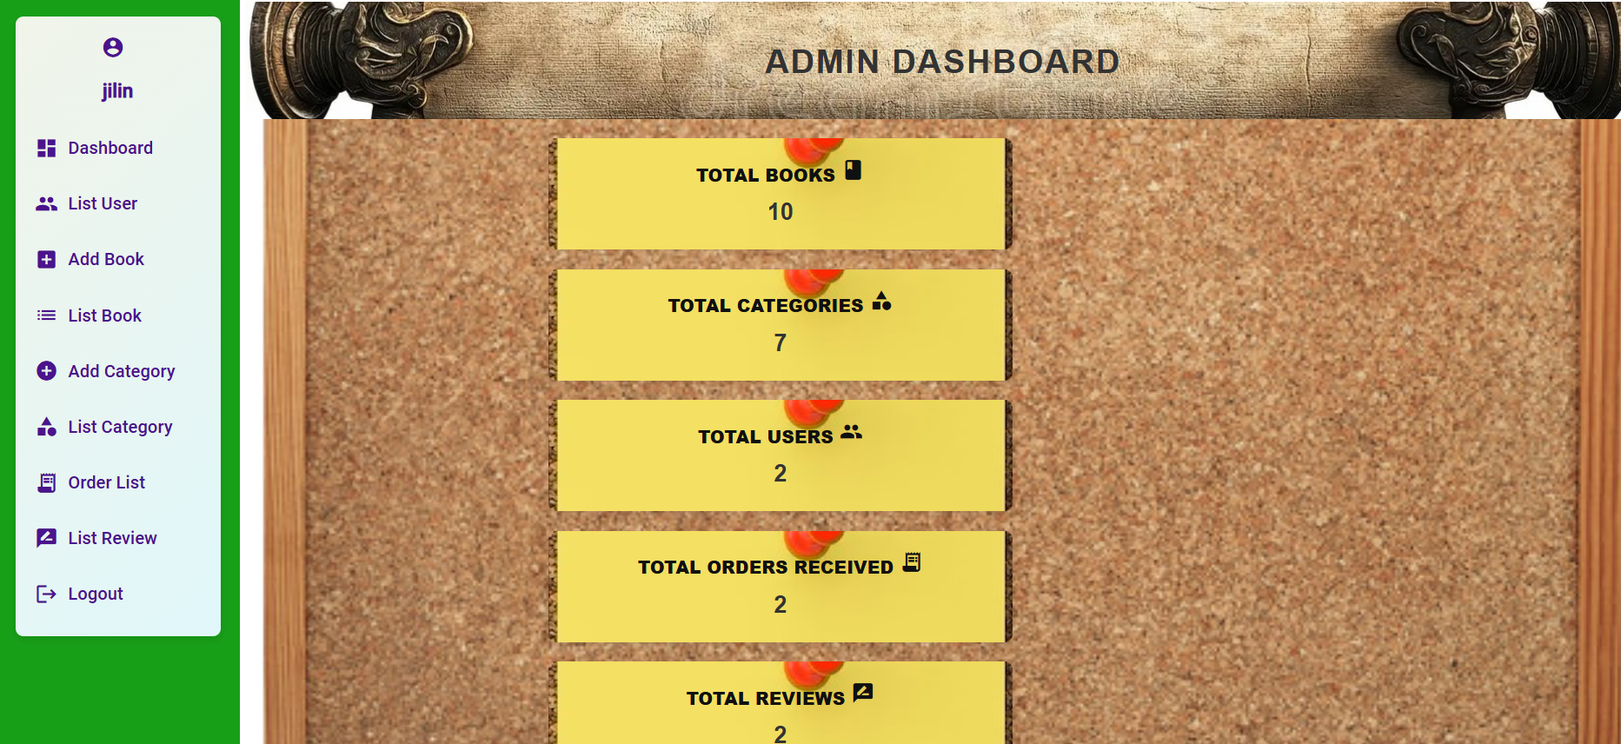
Admin Dashboard Page:-

Slide 20
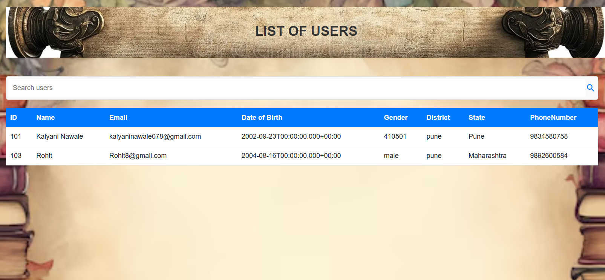
Admin- User List :-

Slide 21
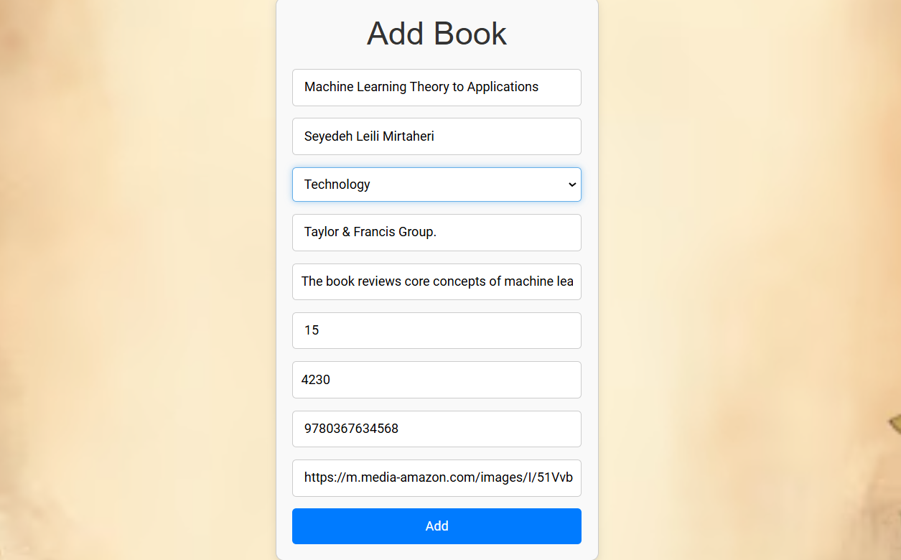
Admin –Add Book:-

Slide 22
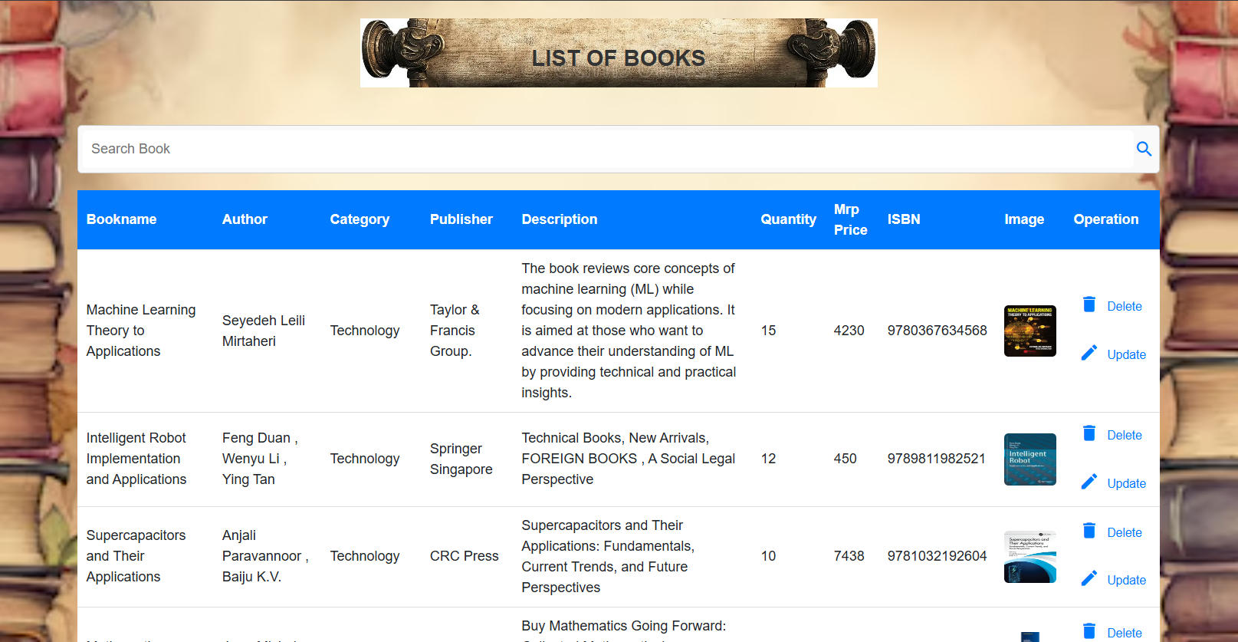
Admin –List of Books:-

Slide 23
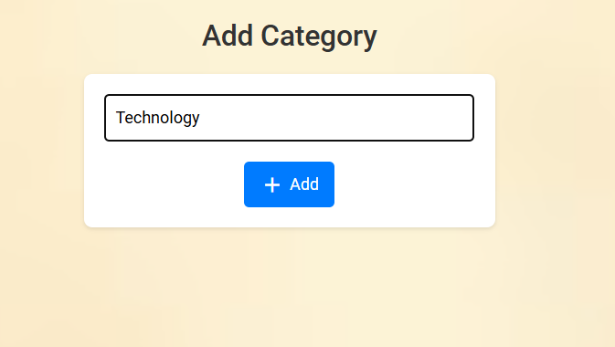
Admin –Add Category:-

Slide 24
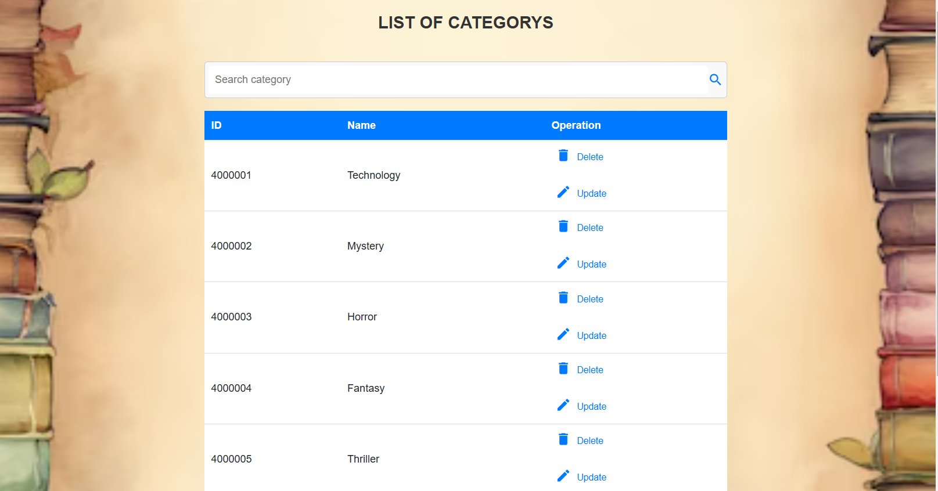
Admin-Category List:-

Slide 25
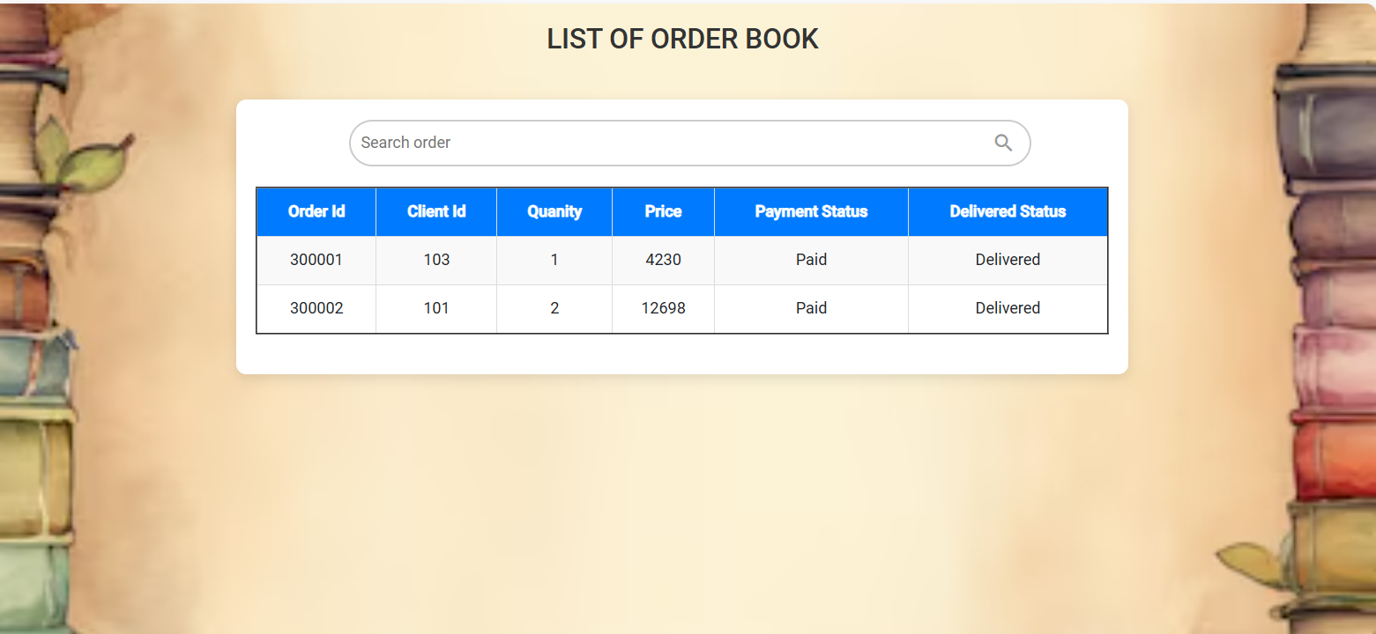
Admin –Ordered Books:-

Slide 26
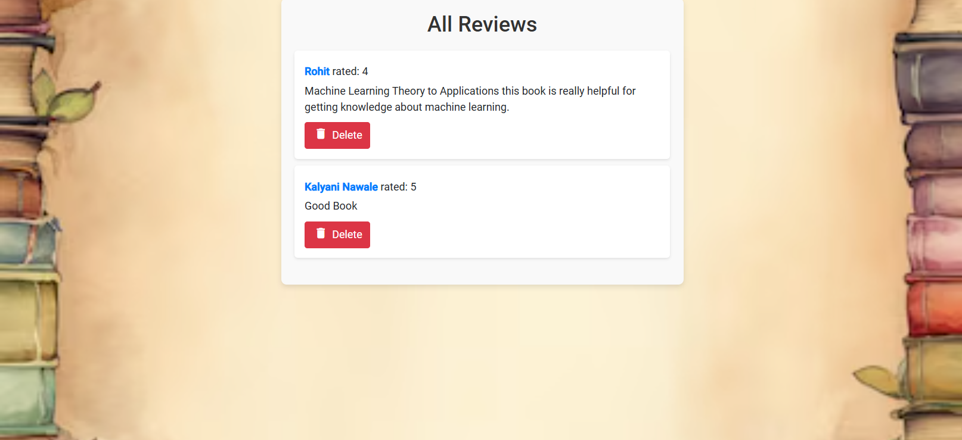
Admin –List of Reviews:-

Slide 27


